Slide 1
Giving every end a new beginning

Slide 2
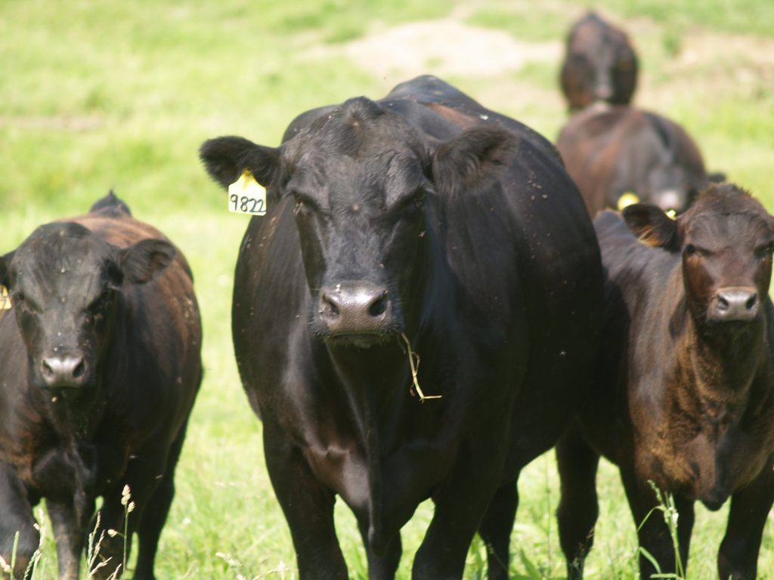
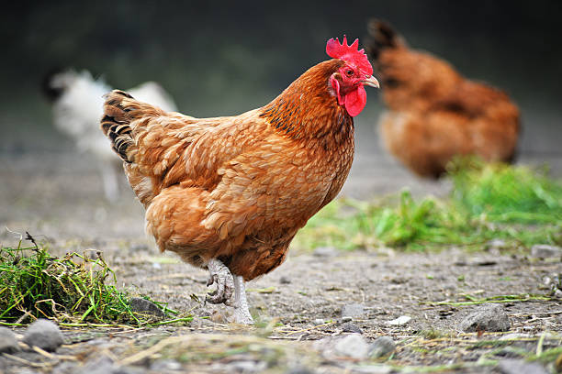
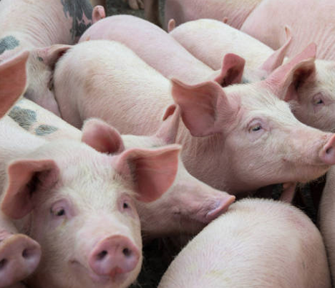
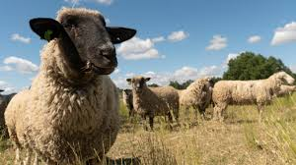
Let’s start with a simple question…
What percentage of each production animal in the U.S. is consumed?
Notes:
Very simple question to start this lesson?​
​
What percentage of production animals do we actually eat in the US?

Slide 3
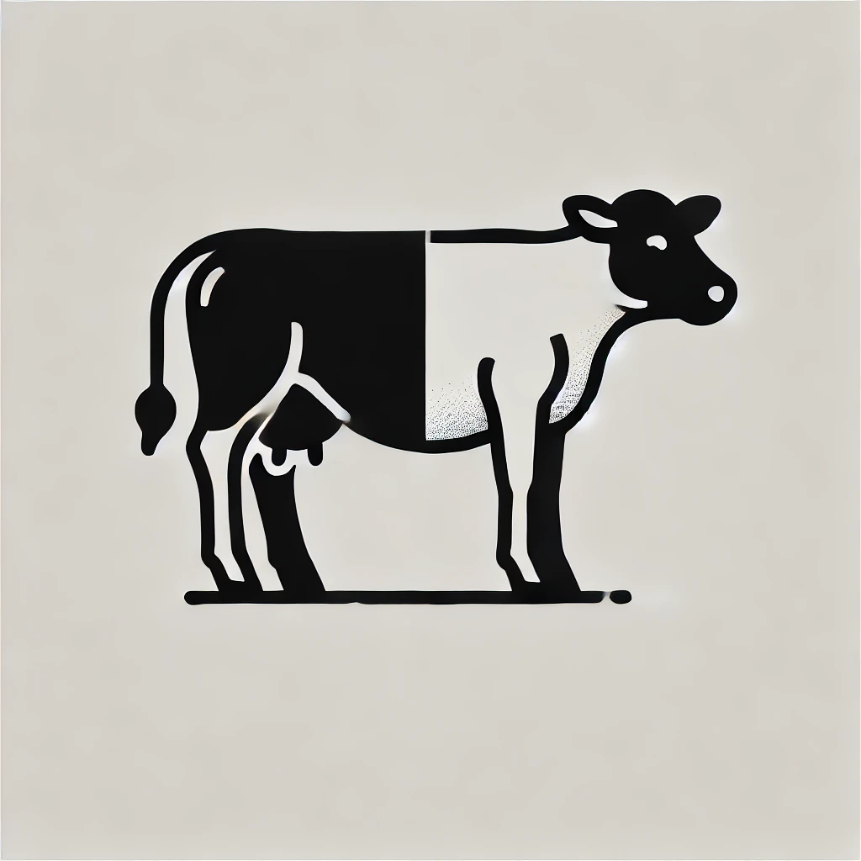
Believe it or not…
Approximately 50% of the animal is considered inedible by Americans and is sent to renderers. This includes bones, fat, blood, feathers and some internal organs.
Notes:
About 50%, that’s taking out all the bones, organs, blood, skin or feathers, and all of the trimmings and fat that is normally removed at the butcher or grocery store. ​
In comparison, other countries, mostly 3rd world countries, do consume more of the animal, than the US. ​
​

Slide 4
Annual U.S. livestock and poultry processing
Cattle and Livestock: 147.2 million head of cattle, calves, hogs and sheep are slaughtered annually in the U.S.
Poultry: 10 billion chickens and turkeys are processed each year in the U.S.
Notes:
So, when we look at what that means in the US annually, there are almost 150 million cattle, hogs, and sheep and 10 Billion chickens and turkeys slaughtered annually. ​

Slide 5
Annual raw material collection by renderers
Renderers gather 56 billion pounds of raw material each year in the U.S. and Canada.
Notes:
And that adds up to around 56 billion pounds of “waste material” produced from those animals that we do not eat in the US. So, where does it go?​
​

Slide 6
Time to start at the beginning…
Notes:
To answer that question, we need to take a bit of a trip back in time.​
​

Slide 7
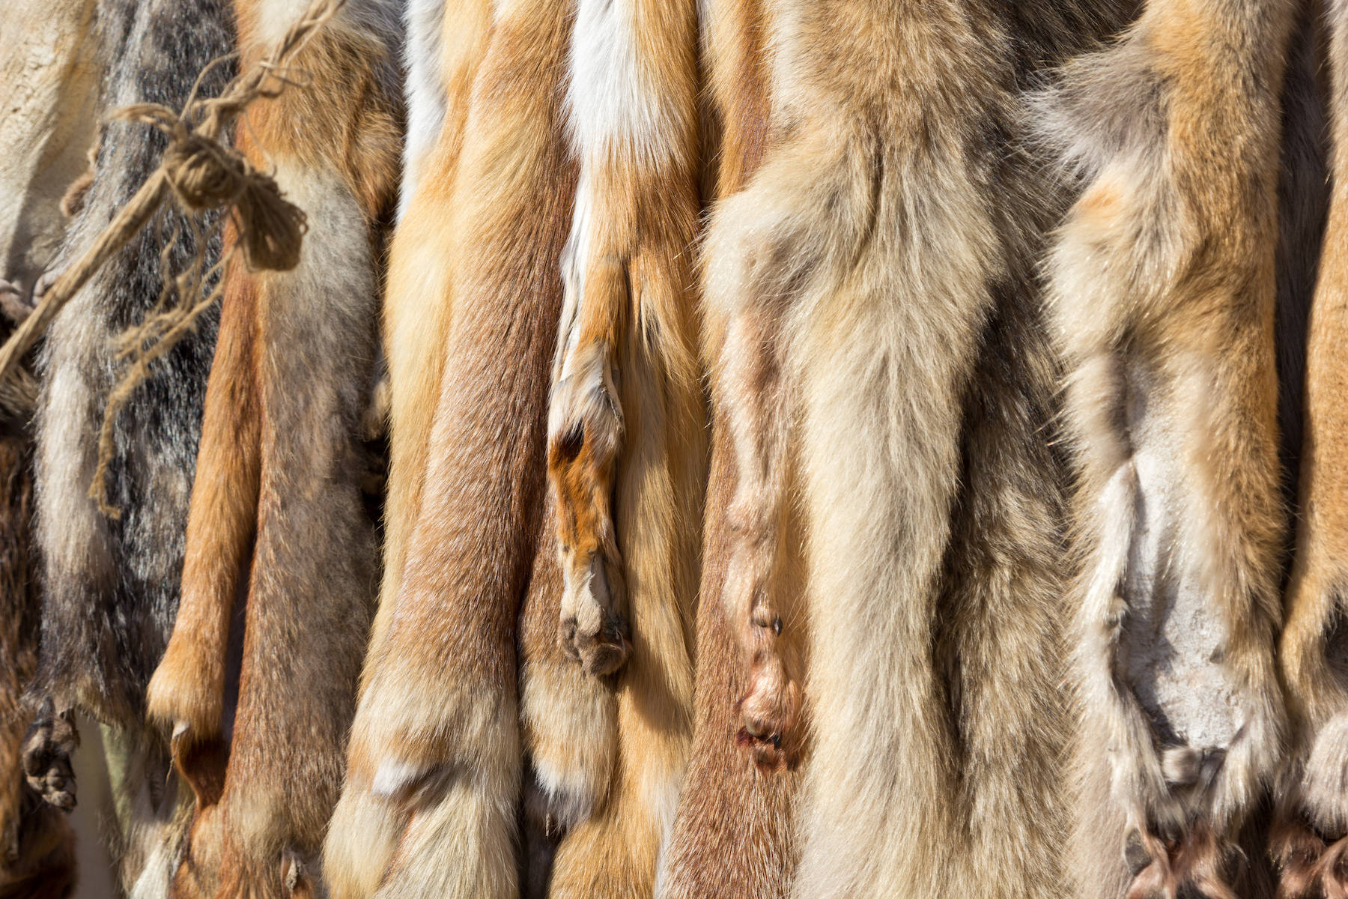
Timeless use of animal resources
Materials and Tools: Hides transformed into clothing, footwear, blankets and shelters; skulls and bones crafted into tools and containers.
Fats and Tendons: Fat used for lotions and hair treatments; tendons made into thread, bow strings and stitching.
Organic Waste: Blood and internal organs repurposed as natural fertilizers.
Notes:
Since the dawn of man, hunters started using every part of the animal. ​
Hides for clothing, shoes, warmth and shelter​
Bones for tools​
Tendons for thread and string​
Even blood for fertilizer​
​

Slide 8
Early candle-making by the ancient Egyptians
In 3000 BC, Ancient Egyptians pioneered candle-making by using melted animal fat and rolled papyrus.
Notes:
Ancient Egyptians 5000 years ago used melted animal fat with a rolled piece of papyrus to create the first candles, used for lighting and heat. ​
​

Slide 9
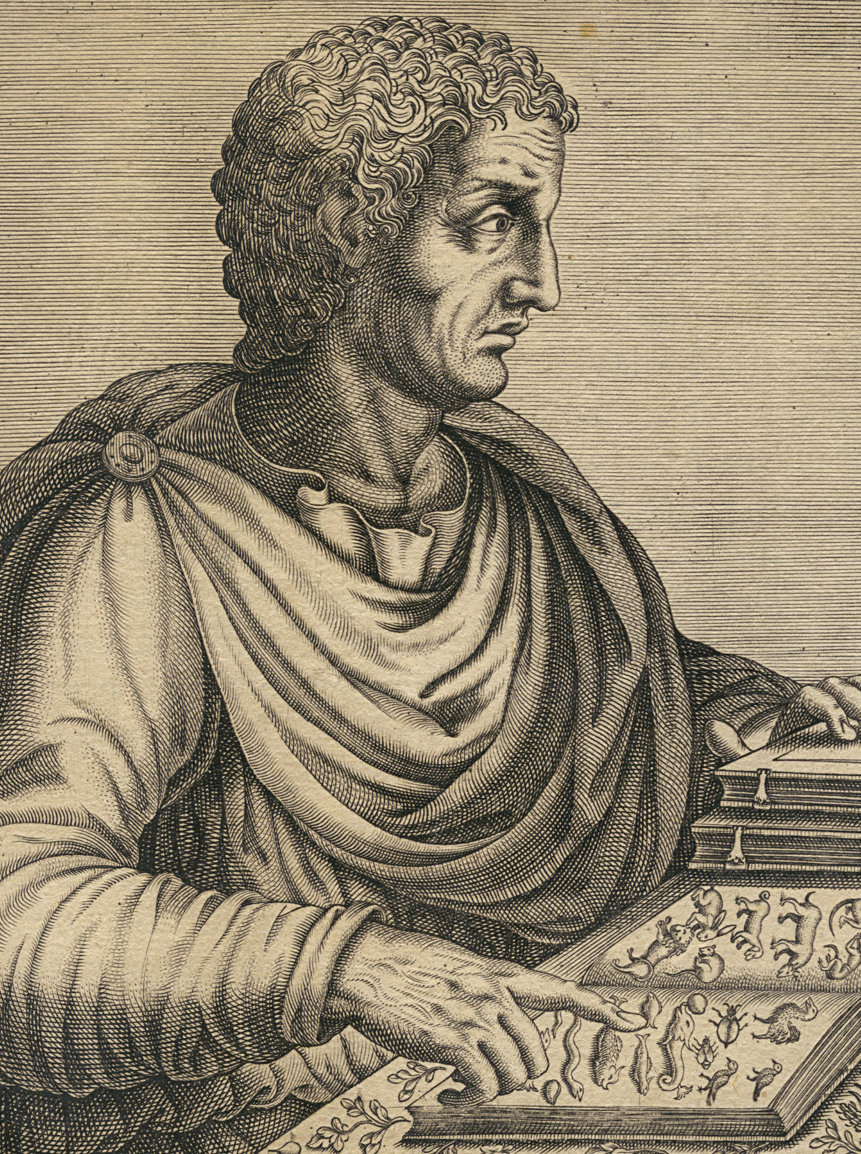
The creation of soap
In 77 AD, Roman scholar Pliny the Elder is credited with creating the first soap using rendered goat fat and wood ashes.
Notes:
However, the first real “break through” in the rendering world was Pliny the Elder​
He realized that with the right combination of goat fat, wood ashes, and a few small ingredients, he could make a something that cleaned with suds​
He had created the first soap ​
​

Slide 10
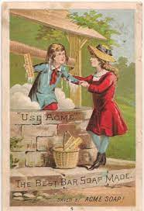
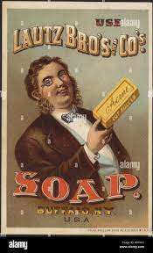
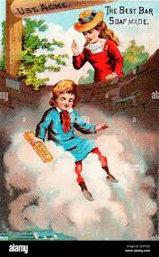
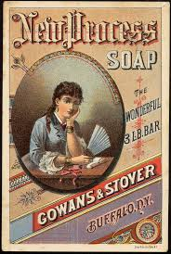
In more recent times… early 1800s
Industry Growth: Expansion of the soap industry led to a boom in the rendering sector.
Major Buyers: Procter & Gamble emerged as a leading purchaser of rendered fat.
Notes:
In more modern times, being clean was much more desirable.​
This created a much bigger soap industry and animal fat becomes a very desirable commodity​
From soaps, to shampoos, cleaners, and laundry detergents and everything in between. ​
​

Slide 11
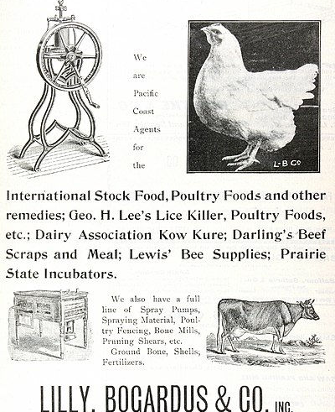
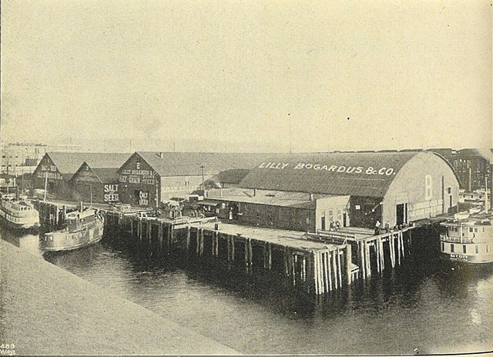
In more recent times… late 1800s
Rendering companies conducted feed trials demonstrating the benefits of incorporating animal proteins and fats into livestock diets.
Notes:
It wasn’t until the later 1800’s that companies realized that the protein meal, left over from getting all of the fat out, was also a useful feed for livestock​
Actually, in this ad, you can see that Darling Ingredients Beef Scraps are on the list. ​
​

Slide 12
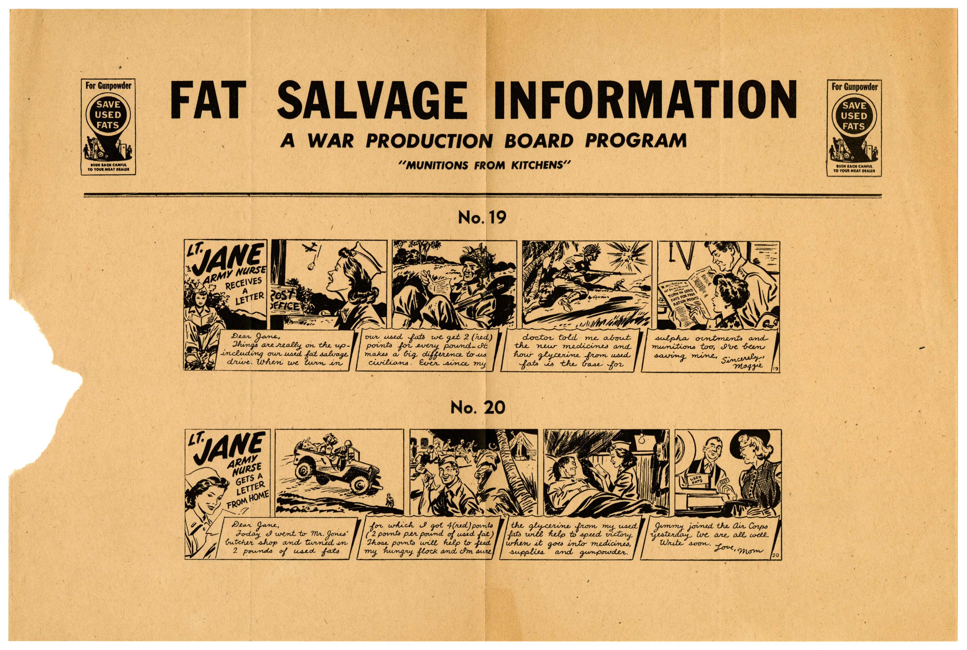
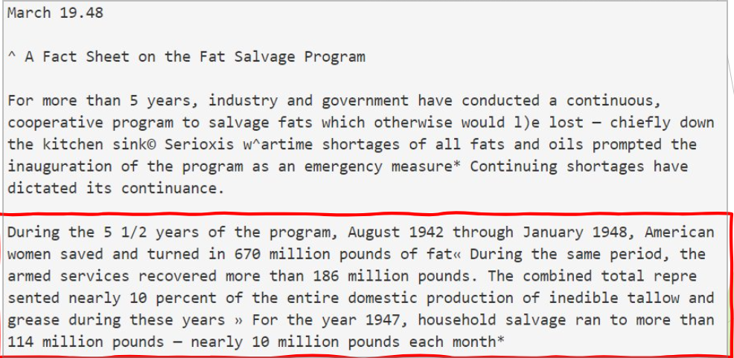
In more recent times… World War II
In the 1940s, the U.S. Armed Services collected fat from household to produce explosives and gunpowder.
Notes:
Fat salvage efforts became very popular during the second World War​
The US government actually asked families to save fat from cooking and donate it to the war effort to make explosives and gunpowder.​
Over the course of the 5 ½ year program, the armed services collected 850 million pounds of inedible fats and oils​
In one year, 1947, households salvaged 114 million pounds of fat, nearly 10 million pounds per month​
​

Slide 13
What is rendering? Watch here.

Slide 14
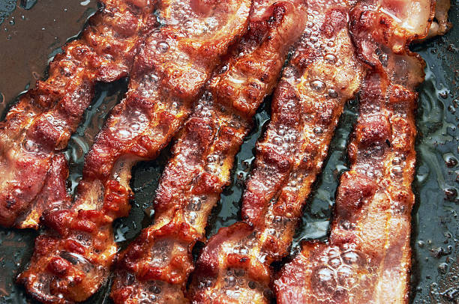
What is rendering?
Rendering is the industrial process of converting animal by-products, such as bones, fat and other waste materials, into usable products like fats, proteins and meal.
This process involves cooking and sanitizing these materials to create ingredients for animal feed, food products and renewable fuels, while also helping to manage waste and improve resource efficiency.
The most common form of rendering:
Notes:
How many of you like bacon?​
So frying bacon is just rendering in its most basic form​
We are heating up the fat and protein “rendering” out the fat ​
Producing ​
Crispy bacon (the protein)​
Fat (the grease left in the pan)​

Slide 15
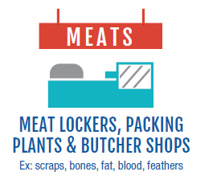
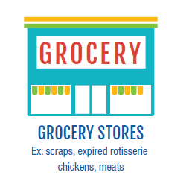
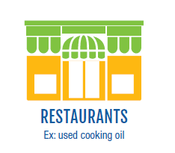
Sources of materials in rendering
Meat Lockers, Packing Plants and Butcher Shops: Render scraps, bones, blood and feathers into useful products.
Grocery Stores: Render expired meats, rotisserie chickens and scraps to recover nutrients.
Restaurants: Render used cooking oil and food waste into renewable fuels and by-products.
Notes:
Let’s examine how the rendering industry works, as a whole.​
Animal parts and oils are collected by the company​
Large meat producers, packing facilities and plants, and butcher shops have materials such as hides/feathers, organs, heads, feet, and trimmings from the slaughtering process​
Grocery stores have the trimmings and leftovers from taking the larger wholesale cuts and making retail cuts of meat for the display cases. They also have meat that might be expired and would traditional be thrown away.​
Restaurants produce gallons and gallons of used cooking oil and grease from food production. ​
​

Slide 16
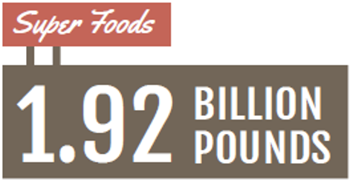
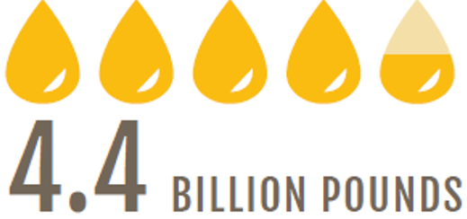
Sources of materials in rendering (cont.)
Grocery Stores: Generate 1.92 billion pounds annually of scraps, fat, bone, expired meat and used cooking oil.
Renderers: Collect 4.4 billion pounds of used cooking oil per year in the U.S. and Canada.
Notes:
Just to give you an idea of the volume of material produced at grocery stores and restaurants each year.​
Local grocery stores produce around 2 billion pounds of scraps ​
Restaurants produce 4 and a half billion pounds of used cooking oil ​
If you remember from earlier, there is about 56 billion pounds of “waste” produced in the slaughter process annually.​
Leaving 50 billion pounds coming from the processors and packing houses​
​
​

Slide 17
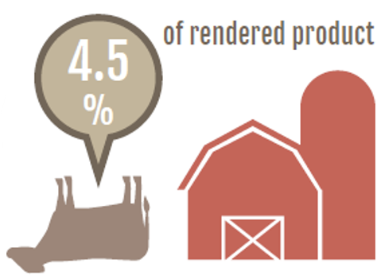
Sources of materials in rendering (cont.)
Deadstock collection: Renderers pick up dead animals from farms due to injury, old age or other issues.
Public health protection: Rendering eliminates pathogens from dead stock, preventing public health hazards.
Dead stock accounts for only about 4.5% of the total rendered product.
Notes:
Not only do renderers take the materials from the meat producers in the US, but they also collect animals that die from natural or other causes on the farm. ​
Fallen farm animals make up about 4.5% of the rendered products in the US​
We will learn later that this is a HUGE benefit to the environment, not allowing these animals to just decompose on the farm. ​
​

Slide 18
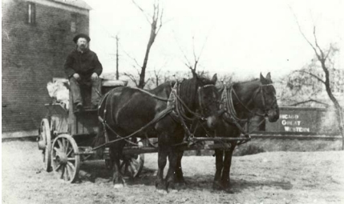
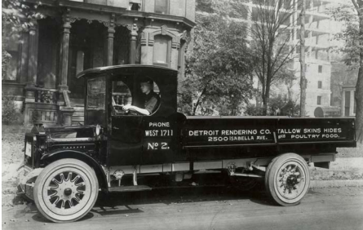
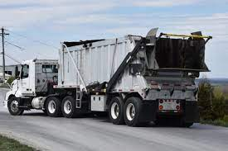
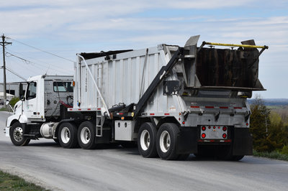
Sources of materials in rendering (cont.)
Evolving fleet of trucks for collecting raw materials over the years:
1880’s
1909
Present Day
Notes:
The first process in the rendering industry is collection of the raw materials.​
Here are a few examples of the variety of that transportation through the years​
Also, some production facilities have gotten smart over the years. ​
They have incorporated an “on-site” rendering facility at their plants​
The rendering plant is directly connected to the processing plant ​
This allows the raw material to be directly fed into the rendering facility while production is ongoing ​
No need for trucking or rail deliveries​

Slide 19
The rendering process
Notes:
Next we are going to take a look at the innerworkings of the rendering facility and how the product actually moves from a raw material, into a finished product. ​
​

Slide 20
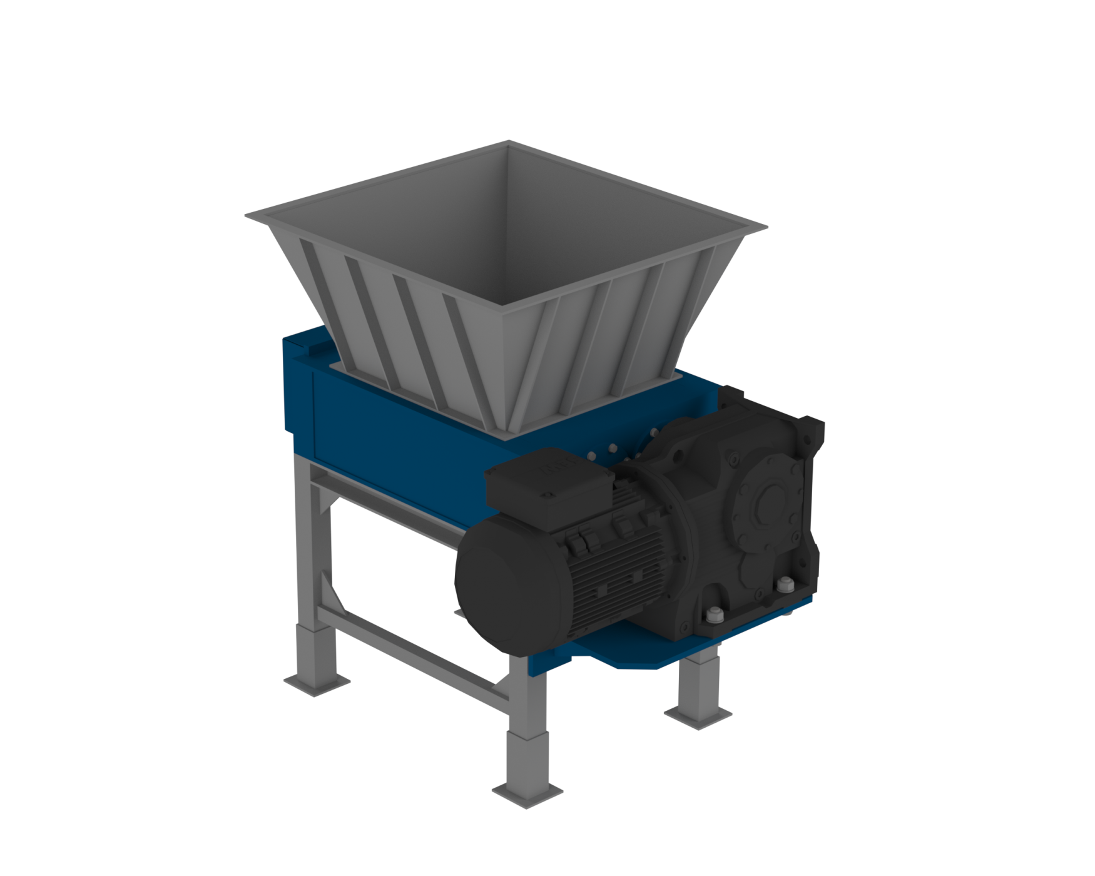
Grinding raw materials
Pregrinders: Equipment used to reduce the size of raw materials before they enter the cookers.
Purpose: Pregrinders break down raw materials into smaller particles for efficient processing.
Benefits: Enhances heat transfer and ensures uniform cooking in the cookers, improving overall process efficiency.
Notes:
When the raw material first enters the plant, it is dumped into large hoppers that feed the pregrinders.​
These reduce the material to a more uniform size before it enters the plant​
If you have ever cooked any bacon, to reference the example before, thick cut bacon will take much longer to cook then thin cut bacon. ​
Renderers want to make sure that the material cooks uniformly and consistently, so uniform size is very important. ​
​

Slide 21
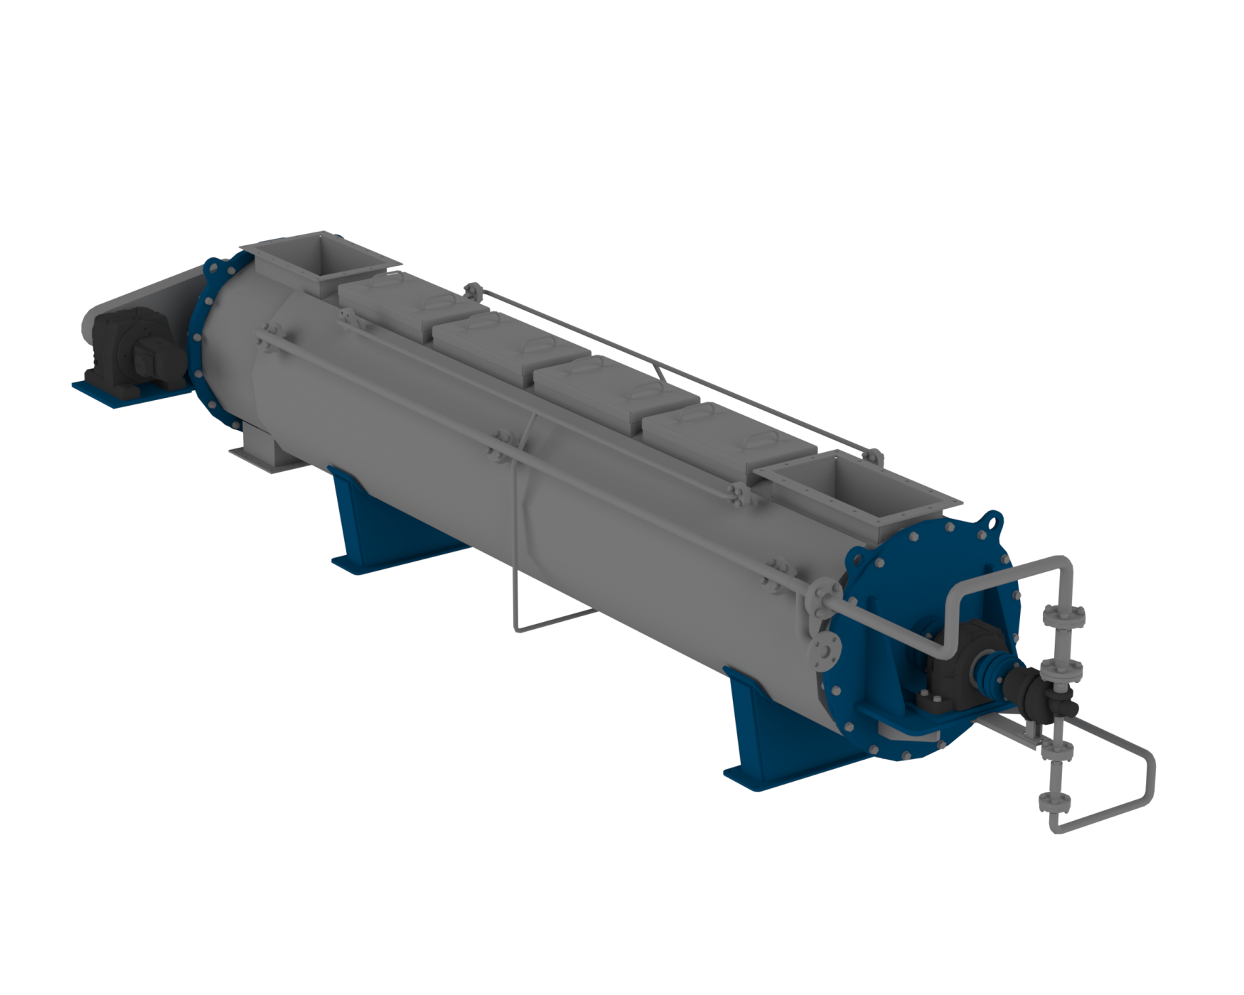
Cooking raw materials
Various cooker types: Includes giant pressurized deep fryers and other industrial cookers used for rendering animal by-products.
Controlled conditions: Cooking is performed at specific temperatures, times and pressures to ensure effective pathogen elimination.
Notes:
From the pregrinders, material is moved, typically with augers or belts, to the cookers.​
There are many different types and methods, but most use a combination of pressure and heat to cook the raw material​
These cookers are virtually big pressurized deep fryers. ​
KFC uses pressurized deep fryers to make chicken. ​
That was their solution to make juicier chicken​
There are certain benchmarks to hit for time, pressure and temperature to kill all of the bad pathogens in the raw material to make it safe to use for feeds​

Slide 22
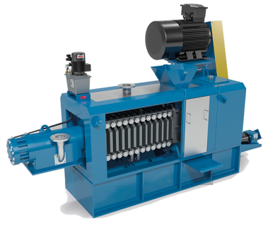
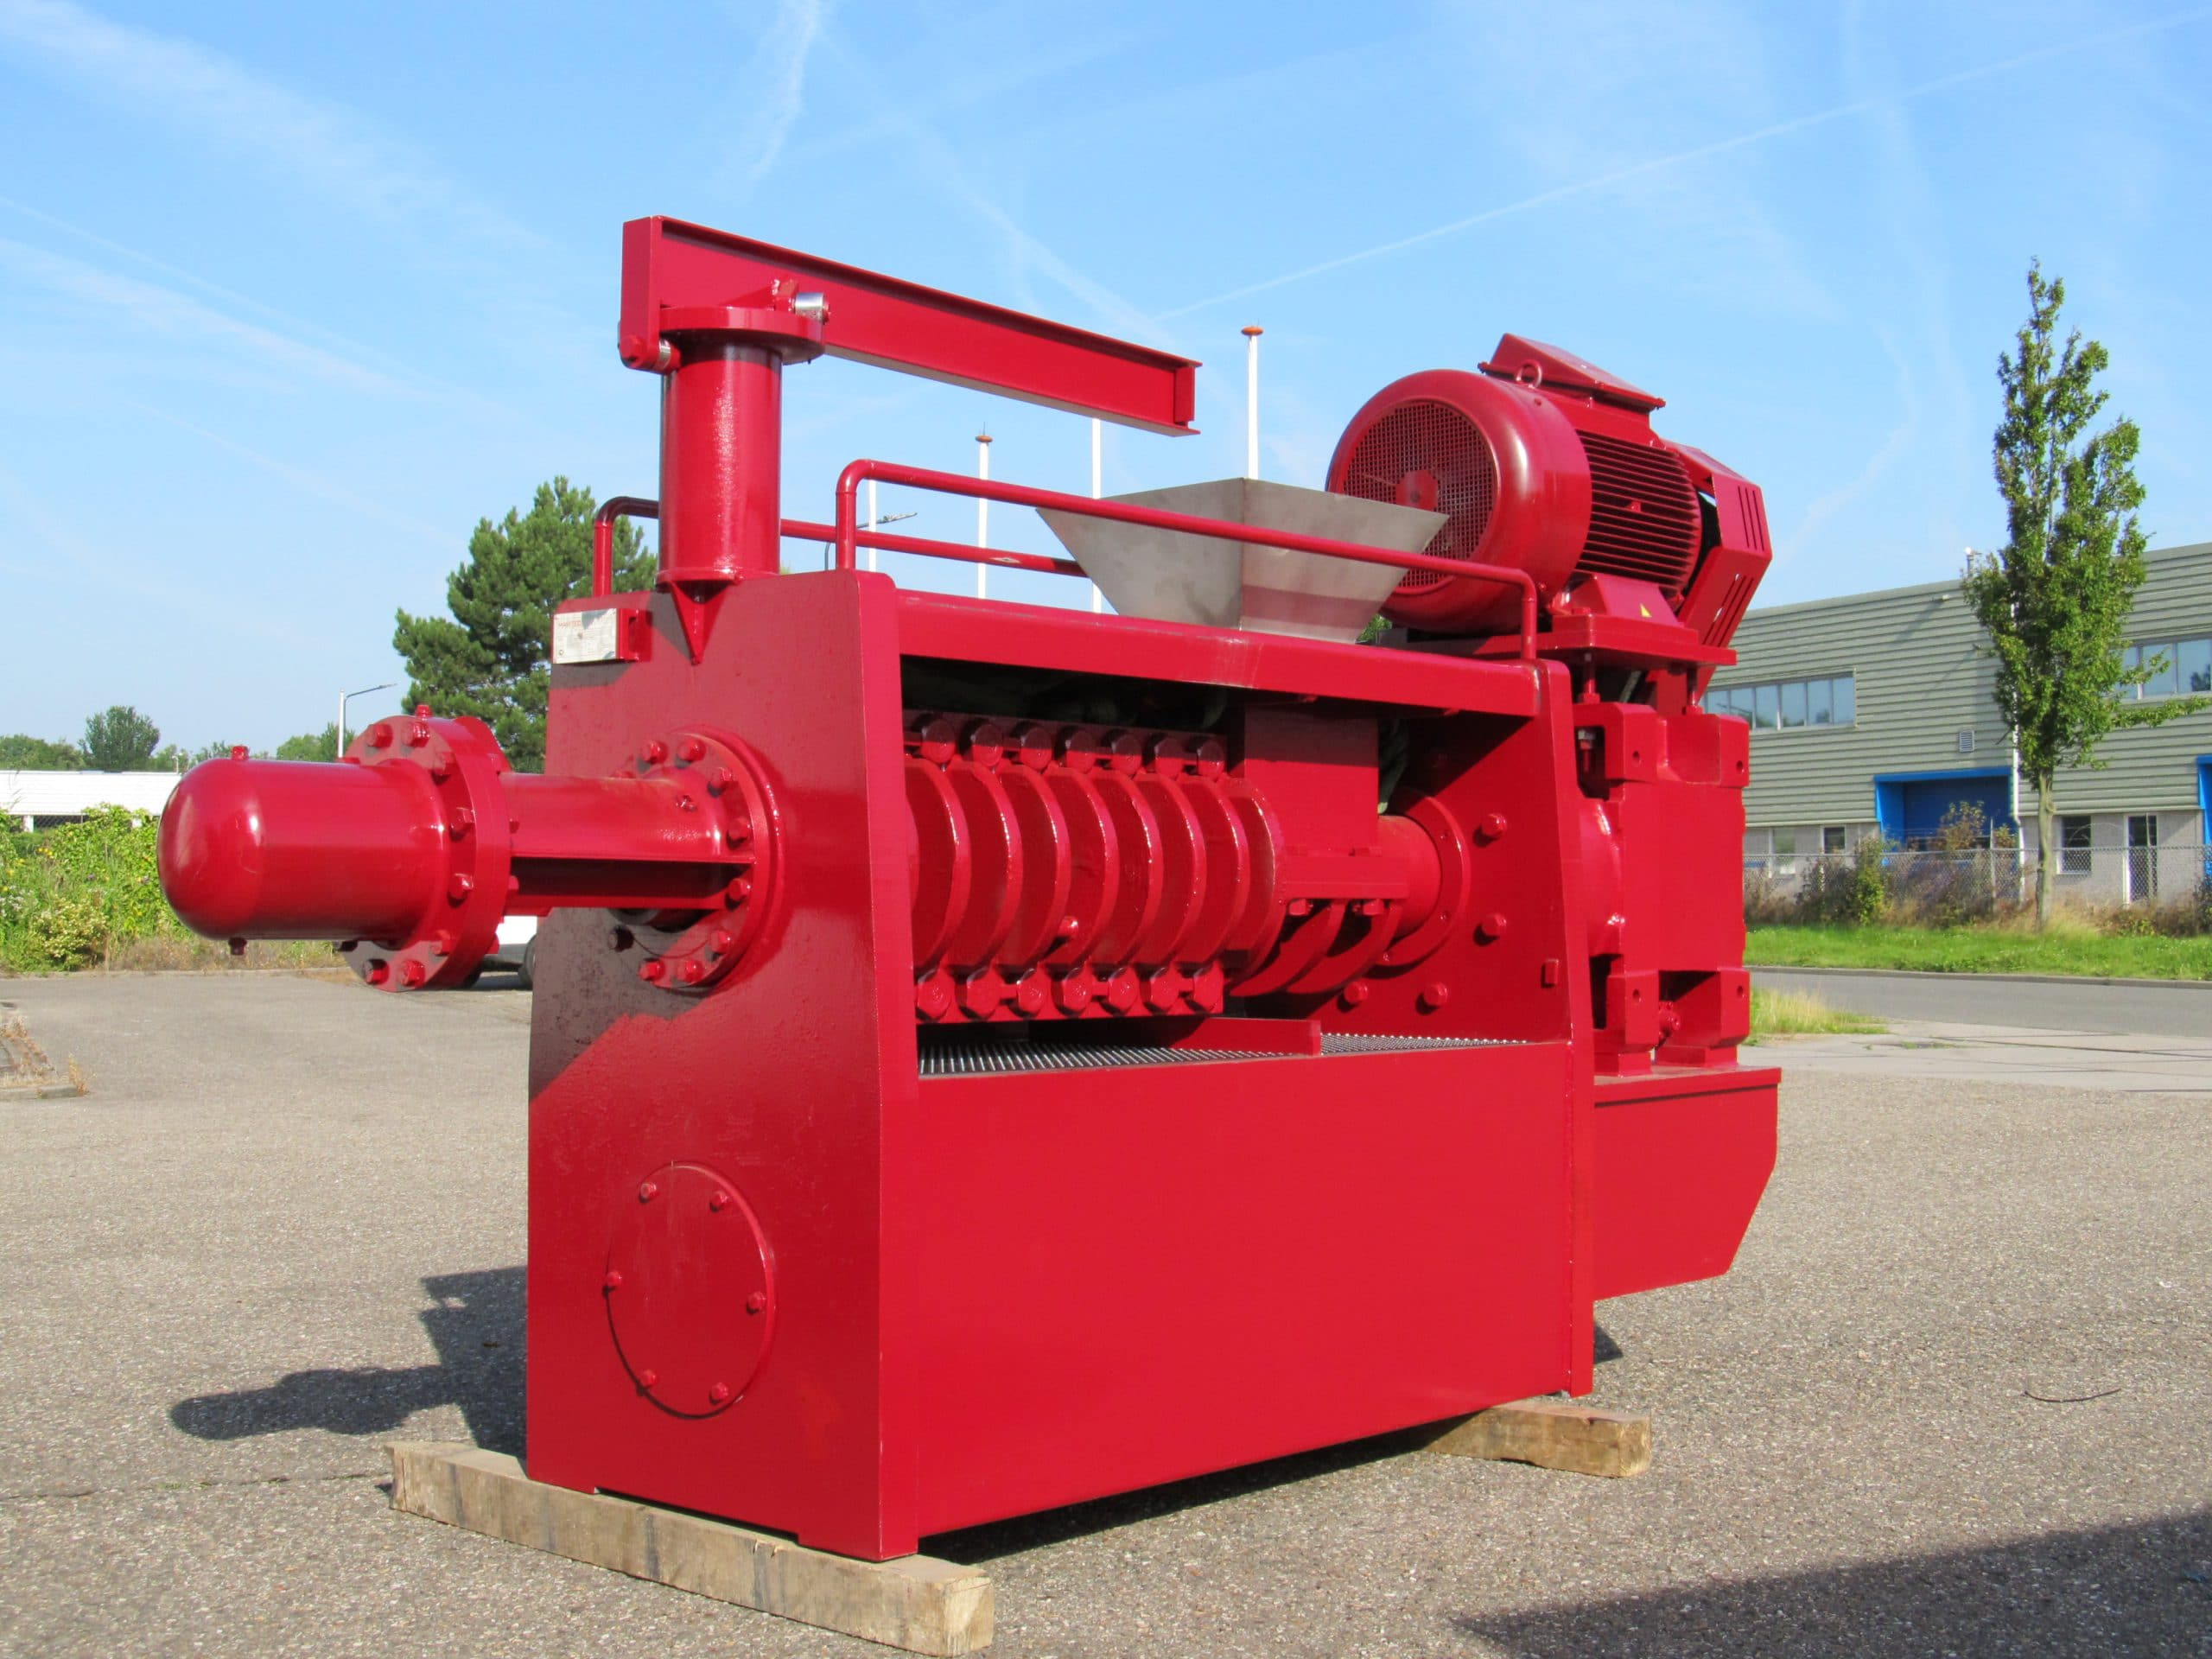
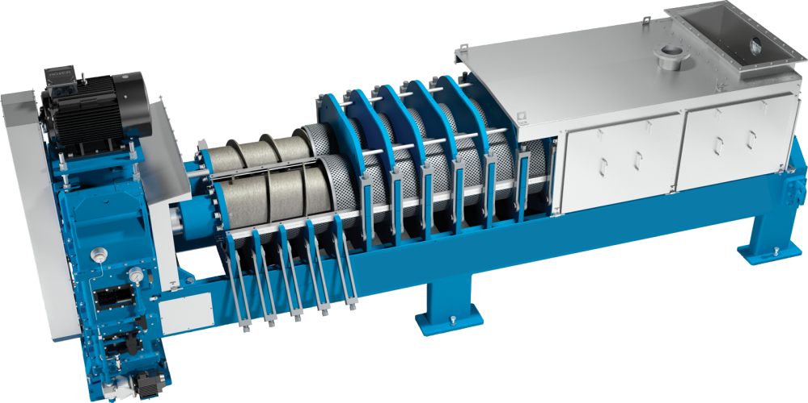
Pressing
Types of presses: Various presses are used in rendering to separate proteins from fat.
Function of presses: Presses are designed to press the material, effectively separating proteins (meal) from fat.
Separation Outcome: Results in distinct products– protein mean and extracted fat– for further processing.
Notes:
From the cookers, renderers want to make sure they have separated the fats from the proteins.​
Presses like these are used to squeeze the material to press all of the fat out of the meal. ​
​

Slide 23
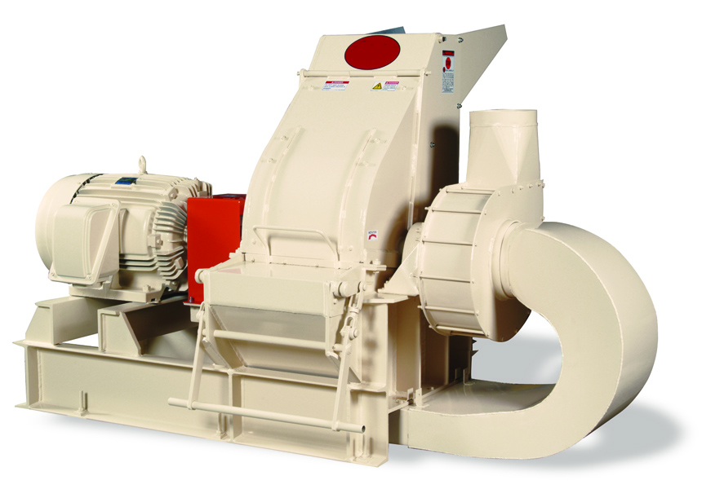
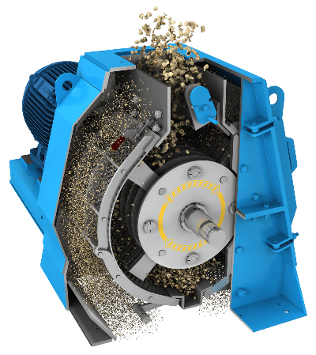
Hammer Mill
Purpose: Breaks down protein meal into smaller, uniform-sized particles.
Functionality: Ensures consistent particle size for improved processing.
Notes:
Now there are 2 separate products, meal and fat​
Let’s look at the meal first​
The meal is usually stuck together in a big brick. So it must be broken down into smaller, more uniform particles in order to be used as feed. ​
​

Slide 24
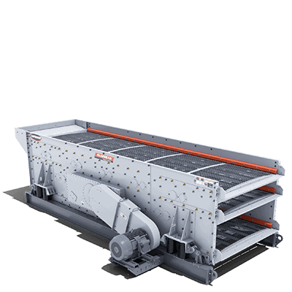
Protein Meal - Screening
Shifting process: Meal is sifted through a screen to insure uniform particle size.
Quality control: Ensures a uniform product by removing oversized particles.
Recycling large particles: Oversized particles are sent back through the hammer mill for further size reduction.
Notes:
When the hammer mills finish with reducing the particle size, renderers use large screens to insure uniform particle size. ​
Any material that is too large for the screen will pass back through the hammer mill to be reduced to a uniform size. ​
​

Slide 25
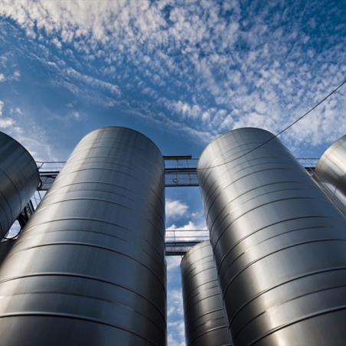
Protein meal – Silos for storage:
Storage: Meal is transferred to storage silos after processing.’
Transport readiness: Stored meal awaits loading onto trucks, railcars or export containers.
Efficient handling: Ensures streamlines transport for further distribution.
Notes:
After the meal is screened to a uniform size, it moved to a silo for storage until it is sold and transported to the final customer​
​

Slide 26
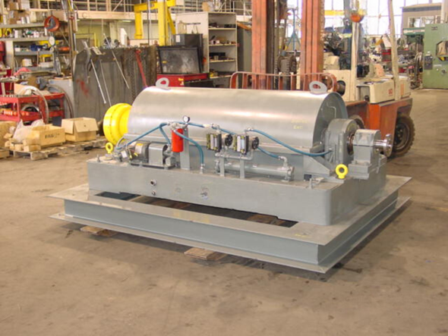
Fats – Purified:
Centrifuge Process: Fat is spun at high speeds to purify fat by removing the remaining solids.
Separation Mechanism: Solids are pushed to the outer edges for effective removal.
Recycling Solids: Extracting solids are sent back to the presses for further processing.
Notes:
Now let’s take a look at the fat ​
Fat at the plant is moved from the presses to a purifying process​
Most renderers us a centrifuge to spin any remaining solids out of the liquid fat​
The liquid is spun very fast and the solids separate, being pushed to the outside​
Any solids removed in this process are sent back to the press.​

Slide 27
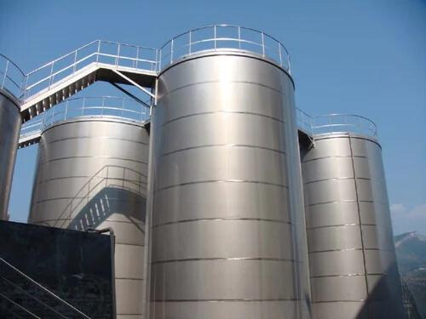
Fats – Tanks for storage
Storage: Cleaned fat is transferred to storage tanks after separation.
Transport readiness: Stored fat awaits loading into tankers, rail tanks or ships for export
Notes:
The finished fats are sent to storage tanks to await delivery to the customer.​
​

Slide 28
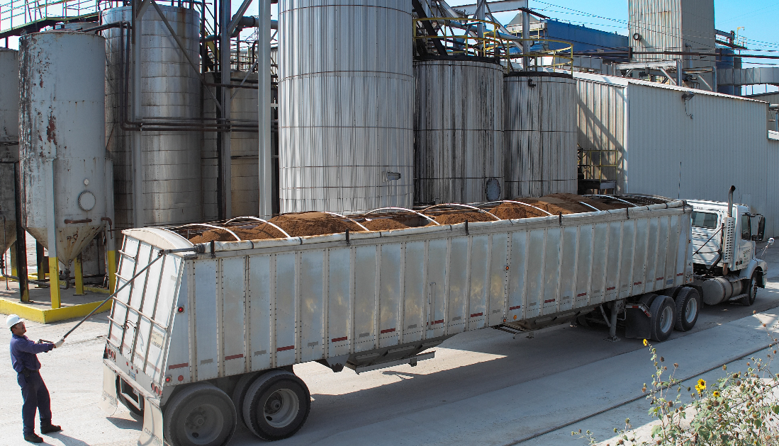
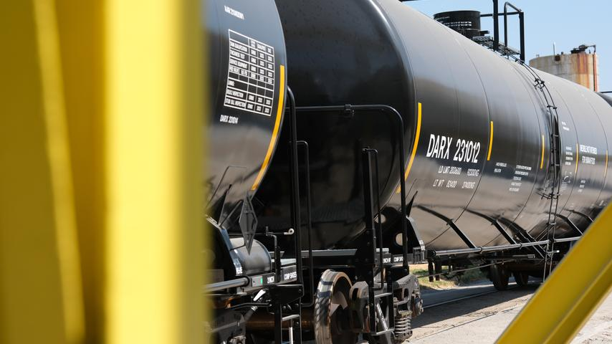
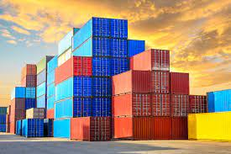
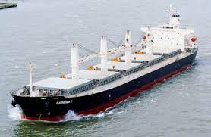
Shipping to customers
Shipments can be made to customers in multiple ways:
Trucks
Railcars
Cargo Containers
Bulk Ships
Notes:
Shipments to customer happen in many different ways​
Trucks deliver product to customers within a few hours of the plant​
Rail cars are utilized to ship product throughout the US, Canada, and Mexico​
Containers are used to export product to multiple countries around the world​
Bulk ships are used to export products to single use countries ​
​

Slide 29
What products are made from rendering?

Slide 30
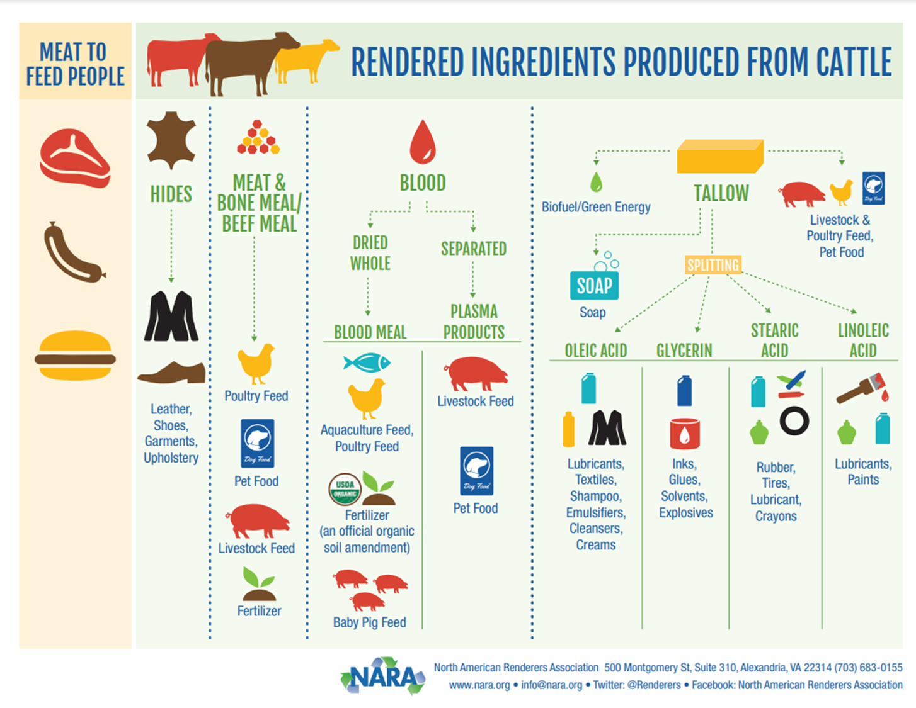
Notes:
Here is a snapshot of all of the rendered ingredients from a cow.​
​

Slide 31
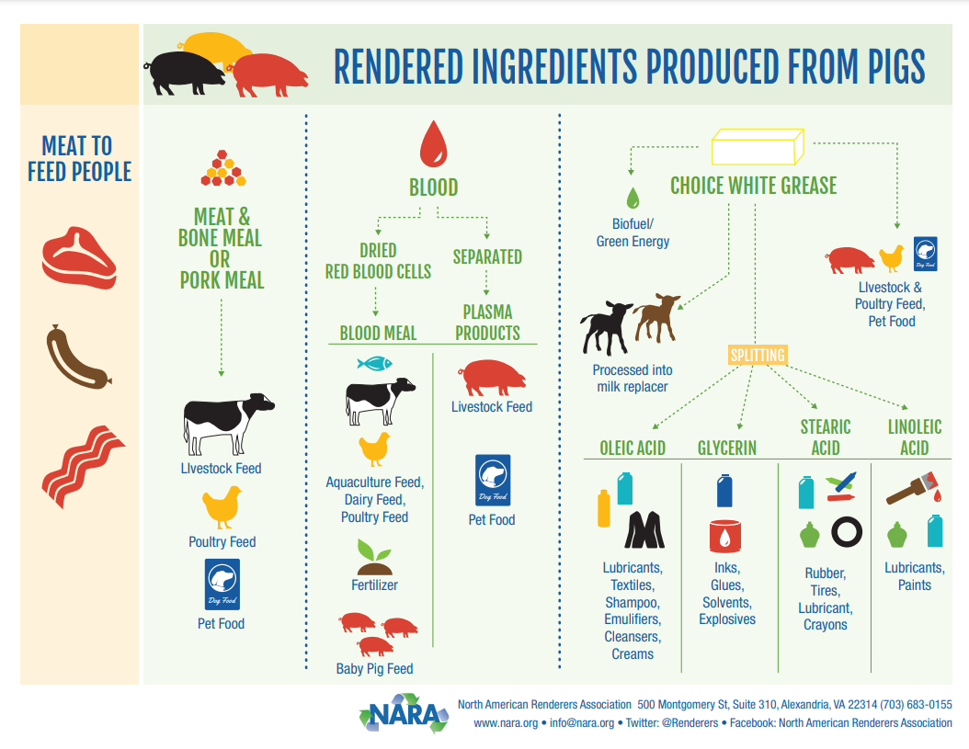
Notes:
A look at what is rendered from a pig.​
​

Slide 32
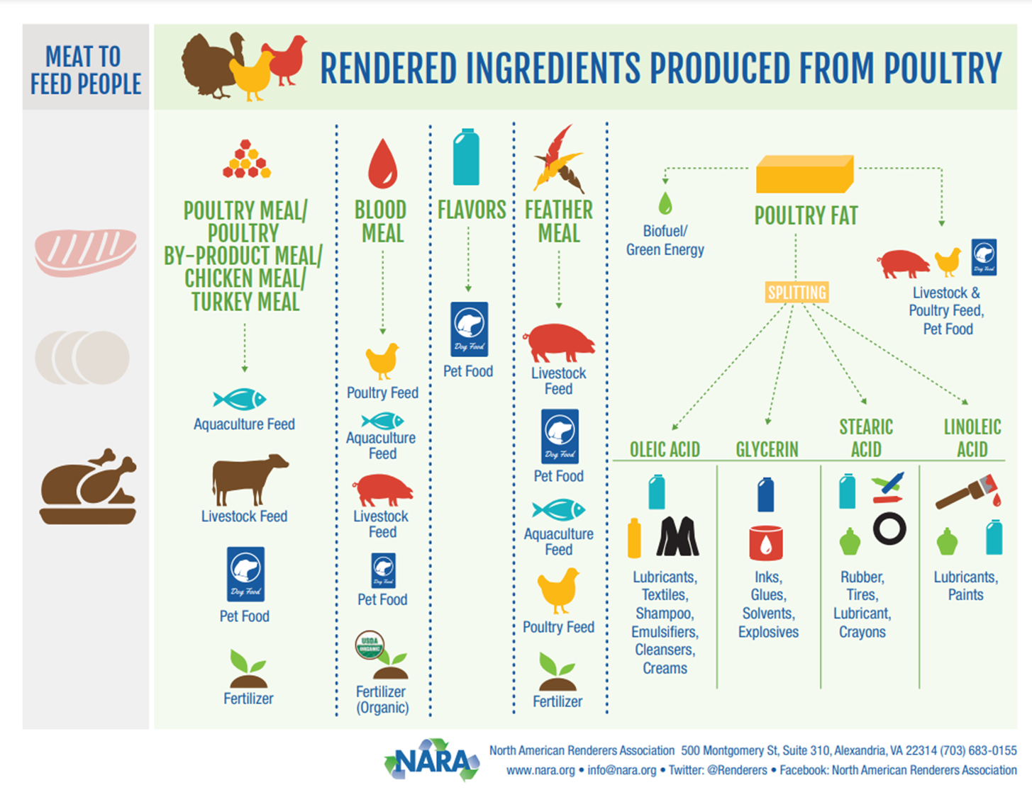
Notes:
And, finally, examples of what comes from the poultry industry.​
​

Slide 33
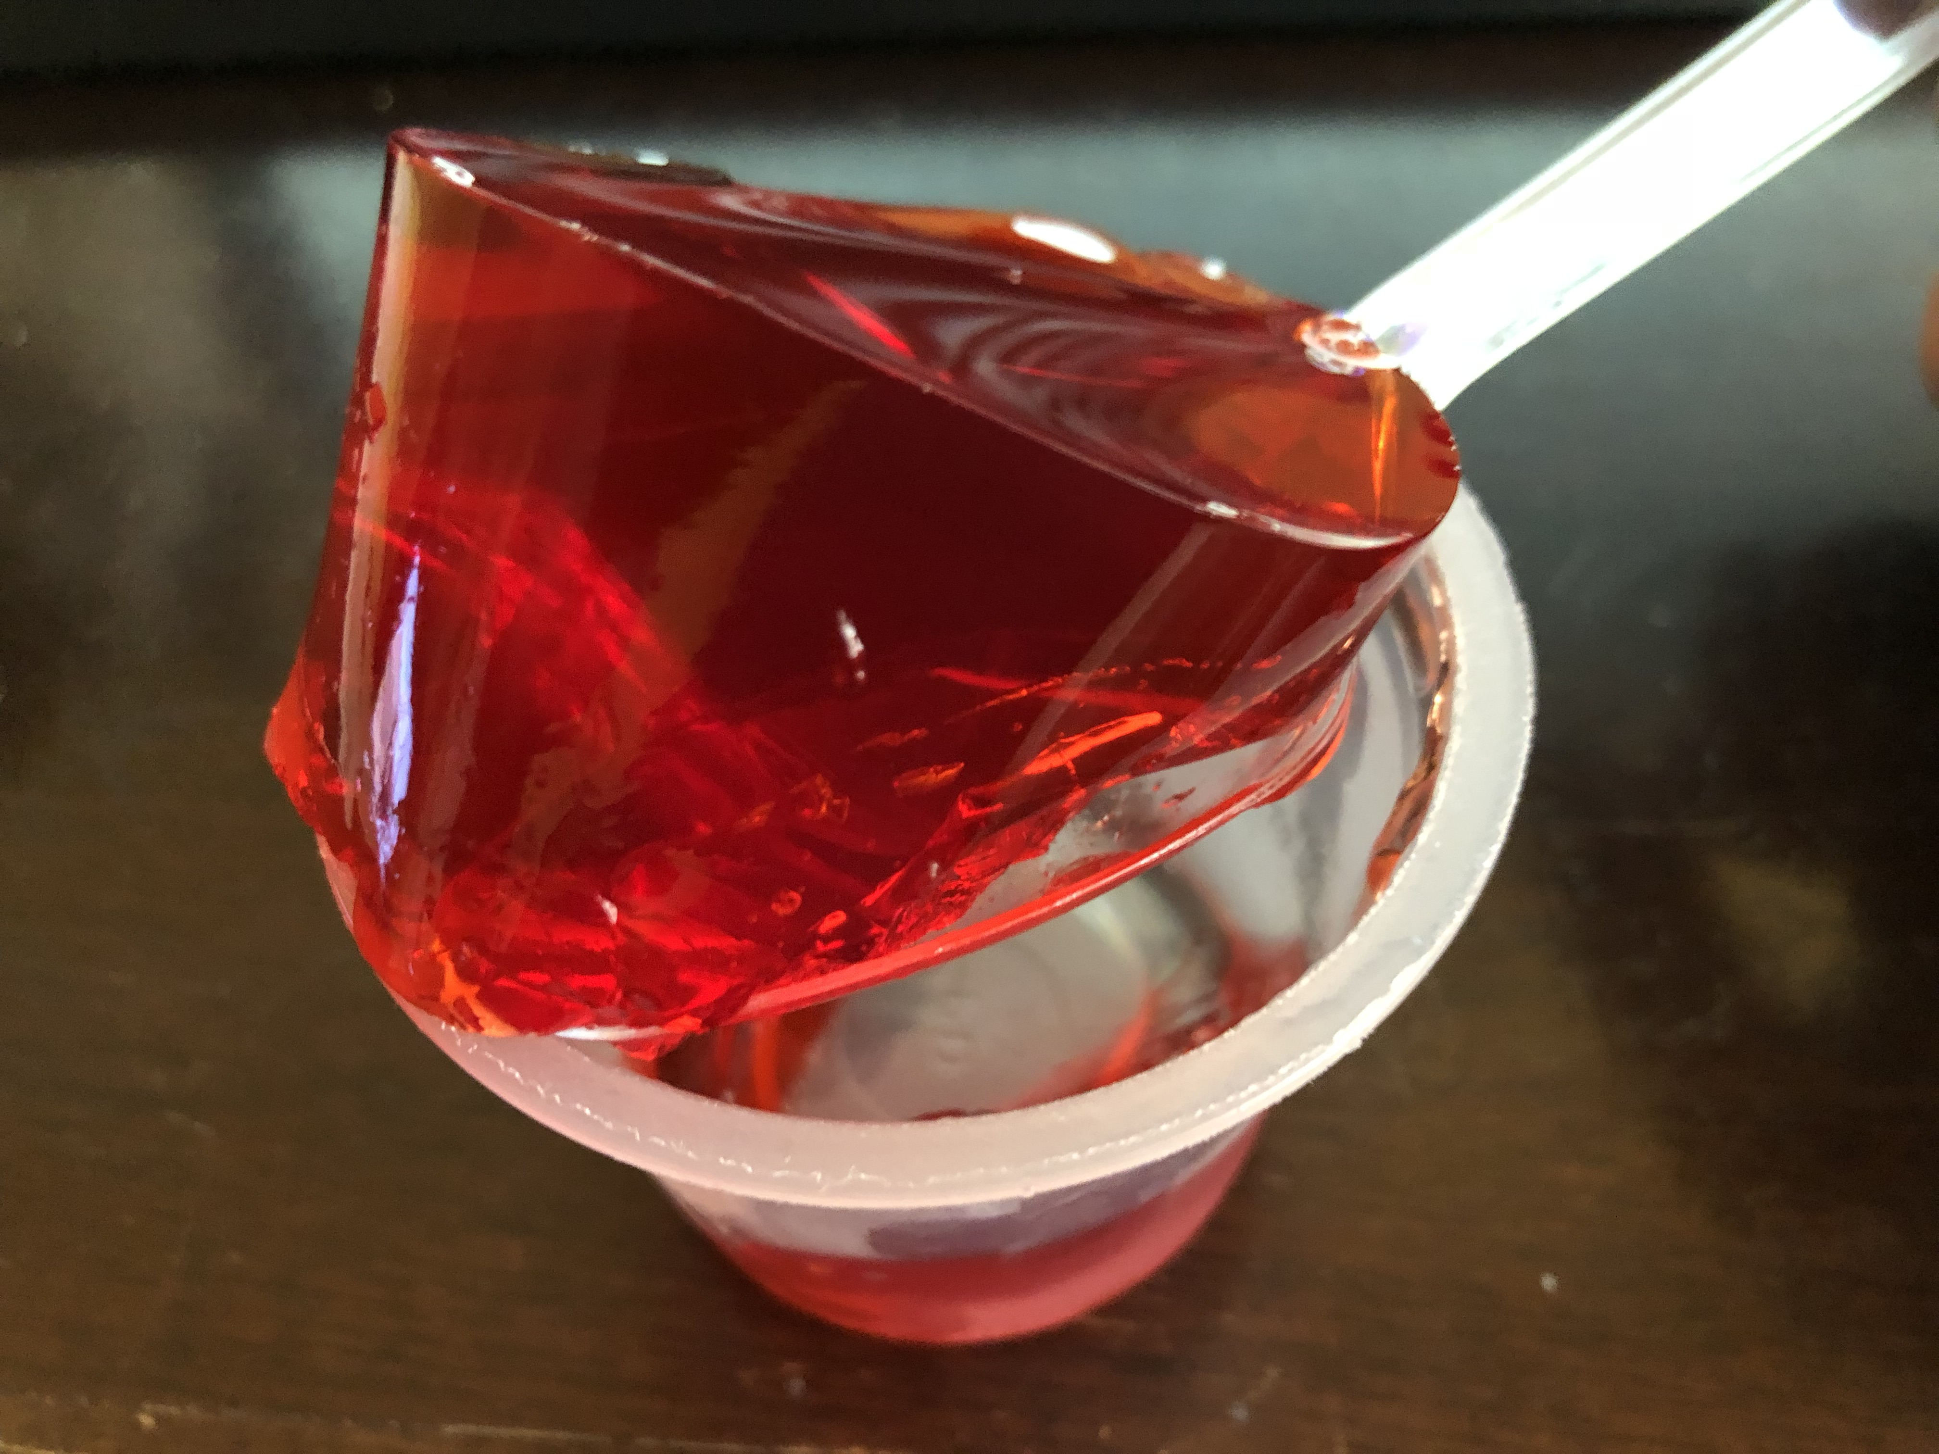
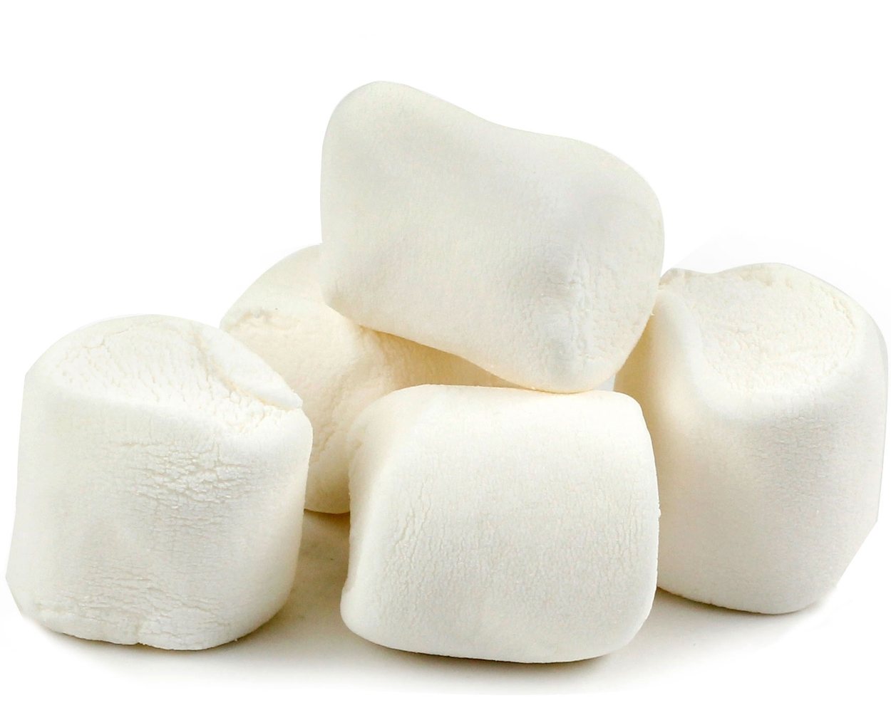
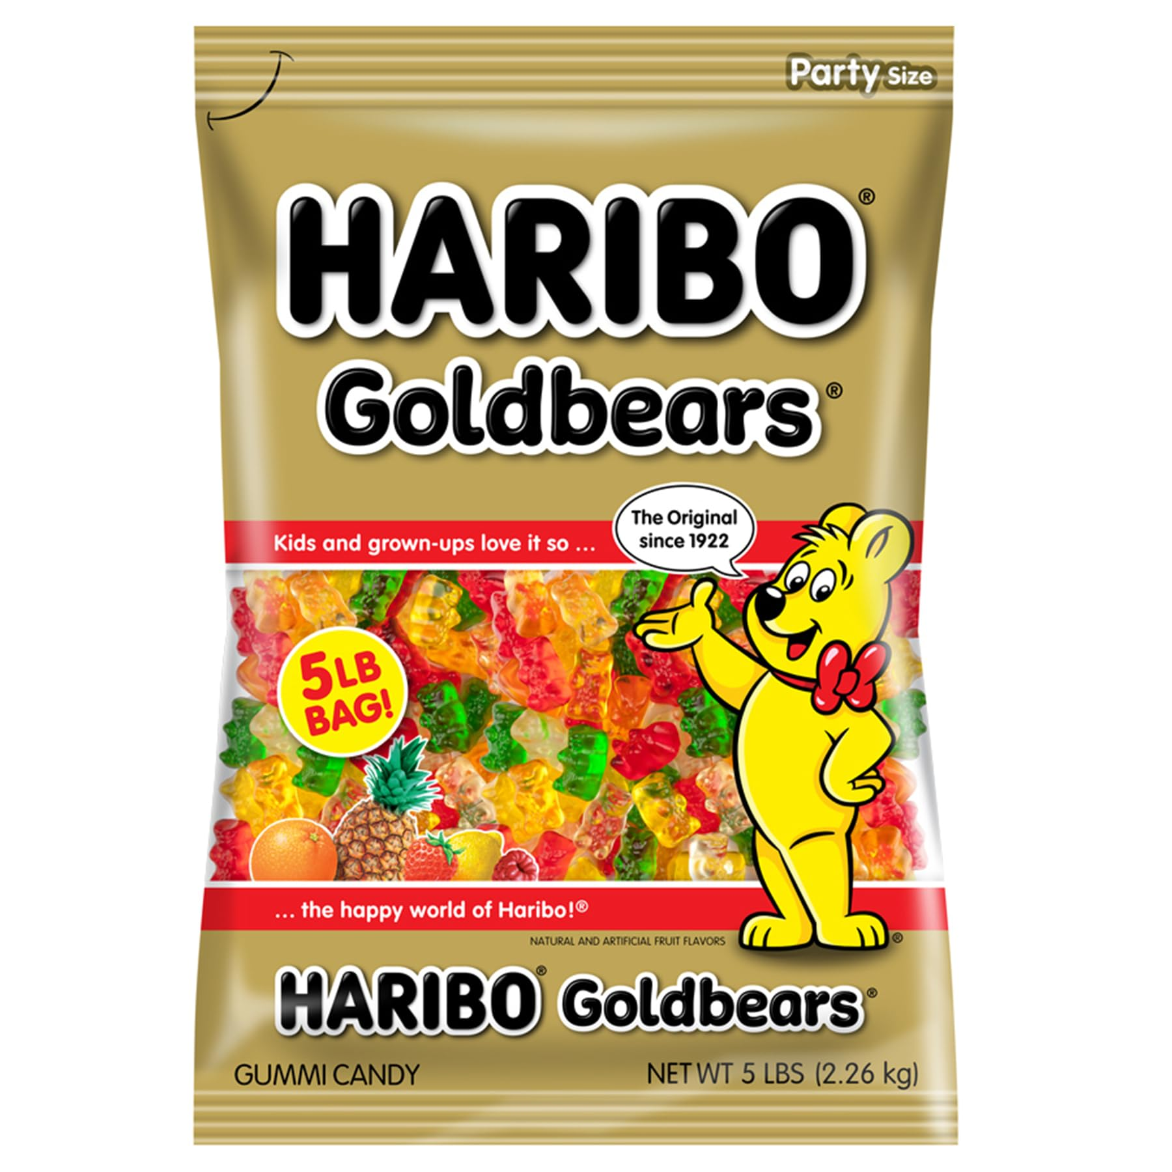
Let’s identify where some common products come from…
We will start with some common foods:
All of these contain gelatin, derived from rendering animal proteins.
Notes:
Starting in the food world​
Gelatin is made in the rendering process ​
Jello, marshmallows, gummies, gum, anything that is sticky or gummy has gelatin as an ingredient. ​
​

Slide 34
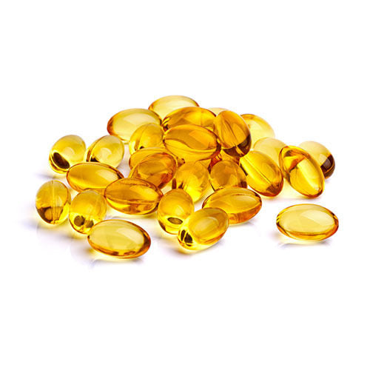
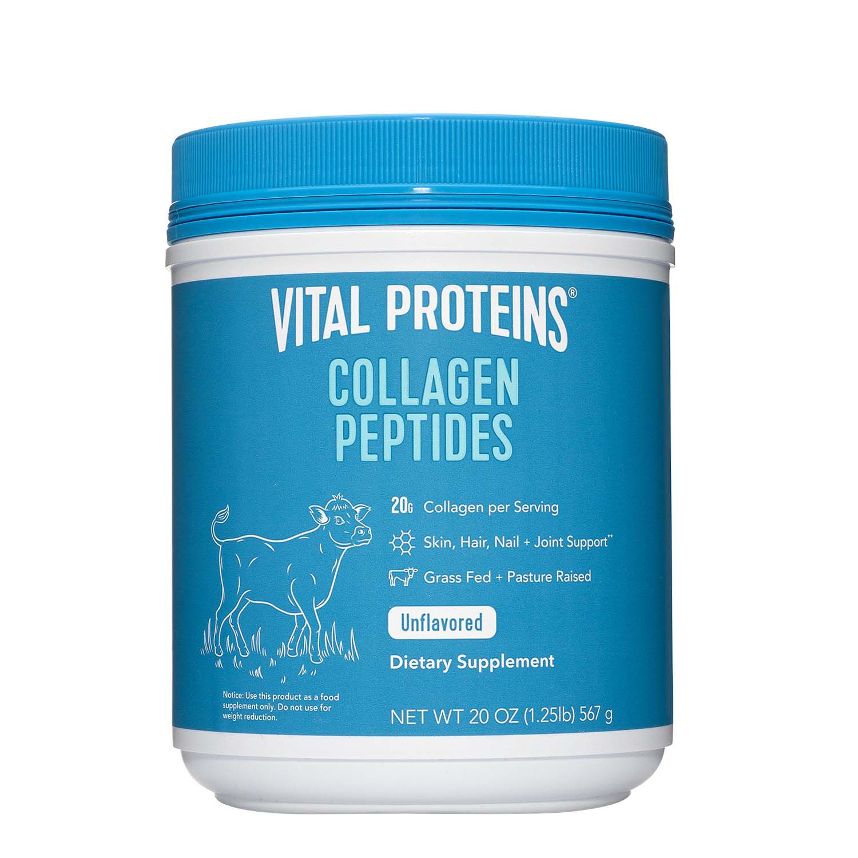
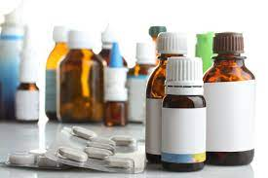
Let’s identify where some common products come from… (cont.)
Gel Capsules: Mostly made from pork by-products.
Collagen Peptides: Derived from animals for joint, bone, skin and nail health.
Medications: Animal-derived ingredients are used in blood thinners, hormone therapies, insulin and vaccines.
Notes:
How about medicines and supplements?​
Gel capsules that hold medication are most made from pork by products​
Supplements like collagen peptides, joint supplements, and certain protein powders contain animal by products to promote healthier joints, bones, skin, and nails.​
Multiple medications are derived directly from animal by-products. Lifesaving medicines have been a result of research by the rendering companies. ​
​

Slide 35
Let’s identify where some common products come from… (cont.)
Lipstick, makeup and lotions contain ingredients from rendered animal fat making the products stay on better and last longer.
Notes:
Make up and lotions contain multiple ingredients that are from the rendering industry ​
Most notable animal fats to make products that stay in place and last longer​

Slide 36
Let’s identify where some common products come from… (cont.)
Tires, fireworks and paint all have ingredients derived from animal fats.
Notes:
There are products that we don’t even think about that are full of animal by products​
Rudder in tires​
Fireworks, explosives, and gunpowders​
Paint​
​
​

Slide 37
Let’s identify where some common products come from… (cont.)
Glues, sandpaper, PVC pipes and plastic bags contain products that come directly from animal by-products.
Notes:
More products that are derived from rendering​
Glues and adhesives​
PVC’s and plastics ​
​

Slide 38
Let’s identify where some common products come from… (cont.)
Athletic equipment contains a large amount of leather, an animal by-product.
Notes:
Multiples uses of animal by-products are the sports industry​
Leather is an animal by product. ​
​

Slide 39
Let’s identify where some common products come from… (cont.)
Rendering and its partners produce 100 million gallons of biodiesel annually. Existing biodiesel technology yields a gallon of fuel for each 7.6 lbs. of fat.
Fuel manufactures are actively working on aviation fuels.
Notes:
Rendering and fuel companies have even figured out how produce renewable diesel ​
Currently working to produce a renewable aviation fuel for planes and jets​
​

Slide 40
What does rendering do for the environment?
Notes:
We have looked at all of the many products that come from rendering, but let’s take a look at all of the many environmental impacts of rendering. ​
​

Slide 41
Rendering is recycling
Keeping scraps out of the landfill:
Rendering transforms the raw materials into 32 billion pounds of new fats, oils and proteins each year.
If rendering was stopped in the United States, how long would it take to fill up all the landfills in the country?
4 years
Notes:
Renderers were the first real recyclers ​
Rendering transforms 50 billion pounds of raw materials into 32 billion pounds of new fats, oils, and proteins annually​
If all rendering operations in the US were to stop, it would only take about 4 years for every landfill in the country to be completely full​
​

Slide 42
Rendering is recycling (cont.)
Keeping scraps out of the landfill:
50 billion pounds of raw materials are produced ever year from farms, feedlots and slaughter facilities.
That would fill the Dallas Cowboys football stadium- 104,000 times
Notes:
Lets take a look at that on a different scale. ​
Rendering collects 50 billion pounds of raw material each year from farms, slaughter houses, grocery stores, and restaurants. ​
That would fill up 104,000 Dallas Cowboys stadiums every year. ​
​

Slide 43
Rendering is recycling (cont.)
Water recovery: Rendering reclaims water from animal by-products, preventing waste.
Sewer protection: Helps avoid grease and oil clogs in sewer systems.
Annual Impact: Recovers 3.7 billion gallons of water each year, returning it to the environment.
Notes:
Not only do renderers keep all of that raw material out of the landfills, they also create clean water​
Animals are mostly made up of water​
Rendering reclaims that water and keeps grease and oil from clogging the sewers and wastewater systems​
3.7 billion gallons of water are reclaimed and returned to the environment each year. ​
​

Slide 44
Rendering is recycling (cont.)
Rendering reduces Greenhouse Gas Emissions (GHG):
Carbon dioxide, methane and other greenhouse gas emissions from natural decomposition are avoided.
One single decomposing cow release 1.2 metric tons of carbon dioxide into the atmosphere
Notes:
As we talked about earlier, rendering companies pick up deceased animals at farms, that have died from various causes​
Natural decomposition releases large amounts of greenhouse gases into the atmosphere​
Buried animals can contaminate ground water​

Slide 45
Rendering is recycling (cont.)
Rendering reduces Greenhouse Gas Emissions (GHG):
GHG emissions are reduced by 72% and fossil fuel usage by 80% when compared to regular diesel fuel
An average rendering plant captures 5 times more GHG emissions from the environment than it produces
Rendering avoids 90% of the potential GHG emissions compared with industrial composting.
Notes:
Rendering helps cut down on greenhouse gas emissions ​
Reducing emissions from vehicles by nearly 80%​
Capturing 5 times more GHG emissions than they produce​
Avoids 90% of the potential GHG emission over industrial composting​
​

Slide 46
Rendering is recycling (cont.)
Rendering reduces Greenhouse Gas Emissions (GHG):
Rendering’s GHG reduction is the same as removing: 18.5 million cars off the road
Notes:
Rendering’s role in reducing greenhouse gas emissions is the equivalent of removing 18.5 million car from the roadways​
​

Slide 47
Rendering is recycling (cont.)
Sustaining the economy
Rendering is sustainable and financially stable, with an annual economic contribution of $10 billion to the U.S. economy.
Rendering employs skilled workers with full-time jobs, many times in rural communities.
Notes:
Rendering also helps sustain the economy​
With an annual economic contribution or $10 billion to the US economy ​
Providing careers to skill workers in rural communities where they may be tougher to find​
​

Slide 48
Who is Darling Ingredients?

Slide 49
A bit of a history lesson…
Ira C. Darling & Company: Established in 1882 in Chicago, Illinois, as a partnership between the Swift family (meatpacking) and the Darling family (fertilizer).
Darling & Company: Incorporated in 1891 as an Illinois Corporation.
Strategic Partnership: Merged expertise in meatpacking and by-product utilization, laying the foundation for future growth.
Notes:
Darling Ingredients’ roots date back to the late 1800’s. ​
Ira C. Darling formed a partnership with a large meatpacking firm in Chicago, IL in 1882​
In 1891, he changed the name to Darling & Company, an Illinois corporation​
​

Slide 50
A bit of a history lesson… (cont.)
1909: Expanded operations into the New York area, broadening its geographic reach.
1920: Further expansion into the Great Lakes region, solidifying its market presence.
1962: Merged to form Darling-Delaware Company Inc., marking a significant milestone in company growth.
Notes:
In 1909, through the acquisition of The Van Iderstine Company, Darling expands into New York​
Soon after in 1920, the company expands into the Great Lakes region​
After about 40 years, Darling acquired entities merge to create the Darling-Delaware Company, Inc. ​
​

Slide 51
A bit of a history lesson… (cont.)
1993: Changed name to Darling International Inc., reflecting a new corporate identity.
2007: Listed on the New York Stock Exchange (NYSE), enhancing visibility and market access.
2013: Began production of Diamond Green Diesel, marking a significant advancement in renewable energy.
Notes:
In 1993, the name is changed to Darling International Inc. to reflect the company’s growth into international trade.​
Darling is listed on the New York Stock Exchange in 2007​
Darling partners with Valero in 2007 to start Diamond Green Diesel​
​

Slide 52
A bit of a history lesson… (cont.)
2014: After several acquisitions and name changes, officially rebranded as Darling Ingredients Inc.
Present Day: Leading the industry as the #1 renderer in North America, with 260+ locations worldwide—150 of those dedicated to rendering in North America—and operations spanning 5 continents. Darling Ingredients continues to expand and acquire companies, strengthening its global footprint and market presence.
Notes:
In 2014, the company undergoes another name change to Darling Ingredients Inc.​
Currently, the company is continuing to expand thought acquisition and growth to expand the global footprint. ​
​The core business is the animal rendering plants​
Darling is currently the worlds largest rendering company ​
In North America alone there are 150 locations throughout the US and Canada​
That makes Darling the largest rendering company in North America

Slide 53
Giving every end a new beginning
We help move the world toward a more circular economy. We restore purpose to millions of tons of material from the animal agriculture and food industries – helping to nourish people, feed animals and crops, and fuel the world with renewable energy.
Collect
We collect materials from the animal agriculture and food industries, helping these industries be more sustainable by providing an alternative to landfilling and incineration.
Process
We separate the materials into fats and proteins, and also extract water – treating and returning more water back to the environment than we use.
Create
We create the highest value for our fats and proteins, which go on to nourish people, feed animals and crops, and fuel the world with renewable energy.
Notes:
Darling’s goal is to Give every end a new beginning
Darling collects, processes, and creates the highest value for animal by-products.

Slide 54
Our operating segments
We repurpose approximately 16 million metric tons of material from the animal agriculture and food industries. We breathe new life into these resources, helping to feed people and pets, provide health and wellness solutions and fuel the world with renewable energy.
Feed
Producing essential ingredients for animal nutrition, fertilizers and renewable fuels
Food
A global leader in ingredients that enhance human health and wellbeing
Fuel
Powering the future with low-emission energy solutions
15%
30%
~1.2
global by-product market share
global market share of gelatin and collagen
billion gallons of renewable fuel produced annually
*Information above is based on 2023 data
Notes:
Darling processed 15% of the global share of by-products
Producing 30% of the gelatin and collagen globally
Creating 1.2 billion gallons of renewable fuels annually

Slide 55
Contributing to a more sustainable world
Contributing to a more sustainable world
15%
10B⁺
2.7B
of the world’s animal by-products processed.
gallons of water returned to the environment
pounds of low CI feedstock for biofuel produced
48K
2M
homes provided with green electricity
CO₂ equivalent of 2 million cars removed from the road
Notes:
Darling Ingredients is working for a more sustainable world
Processing 15% of the world’s animal by-products
Returning over 10 billion gallons of water to the environment
Producing 2.7 billion pounds of low carbon intensity feedstock for biofuels
Providing 48,000 homes with green power
Removing the equivalent of 2 million cars from the roads

Slide 56
Darling Ingredients’ Core Values
Integrity
We are honest, open, ethical and fair. People trust us to adhere to our word.
Transparency
We are authentic and straightforward on reporting our goals, results and practices.
Entrepreneurship
We operate with knowledge, passion and determination.
260+ Locations Worldwide
Operating On 5 Continents
15,000+ Employees
Global Headquarters
Irving, Texas USA
Publicly Traded
since 1994 (NYSE: DAR)
Notes:
The company values are Integrity, transparency, and entrepreneurship
As stated before the company starting in 1882
The global headquarters are in Irving, Texas, just outside of Dallas
Currently employing over 15,000 people
260+ locations in 17 different countries

Slide 57
Darling Ingredients’ brands.

Slide 58
High-Quality Residuals Conversion: They collect bakery and snack food residuals and convert them into high-energy, bio-secure animal feed ingredients.
Comprehensive Service: They offer market-leading equipment, 24-hour maintenance, data collection and consistent pick-up for manufacturing customers.
Notes:
Bakery Feeds even uses the plastic packaging to heat our facilities, so nothing goes to waste​
​

Slide 59
Commitment to quality: At CTH, quality is integral to their vision, ensuring that they consistently deliver reliable ingredients and play a crucial role in your supply chain.
Diverse solutions: CTH specializes in producing natural casings, local food specialties, pet food solutions and pharmaceutical products, with a strong focus on sustainability and trustworthiness.
Notes:
CTH is a division in Europe with multiple products​
Produces high quality natural casings for the sausage industry​
Makes high protein pet food solutions​
Creates highly functional pharmaceuticals ​
​

Slide 60
Used cooking oil services: Provide recycling, collection and storage solutions for efficient and safe handling of used fryer oil to their 225,000 customers.
Grease trap management: Offer regular cleaning and pumping services to ensure compliance with local and federal requirements.
Comprehensive equipment and solutions: Supply a wide range of grease collection equipment and customized services for used cooking oil and inedible meat by-products.
Notes:
Dar Pro is the restaurant services division of Darling ​
Offering restaurants cooking oil collection, recycling, and storage services​
Meat and scrap by-product containment, collection and recycling​
Servicing over 225.000 restaurants nationally​
​

Slide 61
Leading producer: Diamond Green Diesel (DGD) is one of the world’s largest producers of renewable diesel, producing 1.2 billion gallons annually.
Sustainable fuel: The renewable diesel produced is 100% compatible with existing engines and infrastructure, using recycled animal fats and used cooking oil.
Environmental impact: The fuel achieves up to 80% reduction in lifecycle greenhouse gas emissions compared to traditional duels, contributing significantly to lower carbon intensity.
Notes:
Diamond Green Diesel is the joint venture with Valero to produce biofuels with plants in Texas and Louisiana​
Currently producing renewable diesel and building a facility to produce renewable aviation fuels​
Here is a video to explain the process​
​

Slide 62
Innovative protein solution: EnviroFlight uses black soldier fly larvae (BSFL) to address the global demand for animal-derived protein, providing a sustainable alternative for a growing population.
Cutting-edge research: They lead in BSFL research, focusing on genetics, biology and nutrition to develop high-quality, nutritionally consistent ingredients for bother animal feed and plant nutrition.
Sustainable production: BSFL offer up to 1-2 million pounds of protein per acre annually, utilizing upcycled feed and generating minimal waste, making them a highly efficient and eco-friendly solution.
Notes:
Enviroflight is the Black Soldier Fly production division of Darling ​
Larvae are used to produce meals and fats for the feed industry​
Using less acreage to produce more protein​

Slide 63
Expert residual repurposing: Ecoson specializes in transforming residuals into renewable resources, focusing on manure, organic food waste and swill from restaurants and food manufacturers.
Collaborative local partnerships: They work closely with local partners to efficiently collect and process waste materials, ensuring a sustainable approach to resource management.
High-quality solutions: Their processes convert collected materials into high-quality, high-value solutions, contributing to environmental sustainability and resource efficiency.
Notes:
Ecoson repurposes manure, organic food waste, and swill into renewable resources.
They partner with local businesses for efficient, sustainable waste collection.
Their processes create high-quality, valuable products that promote sustainability.

Slide 64
Diverse industry connections: The FASA Group has established commercial relationships with major feed producers across the poultry, swine and fish industries, as well as in pet food, biodiesel/renewable energy and hygiene/cleaning sectors both in Brazil and internationally.
Broad International Reach: Their operations span a global network, including key markets such as Chile, Argentina, Uruguay, Paraguay, Columbia, Ecuador, Peru, Venezuela and numerous countries across Asia, Africa and the Americas.
Notes:
FASA is Darling’s animal rendering division in South America​
15+ processing facilities in South America​
Here are the brands that FASA operates under in South America​
​

Slide 65
Global presence: Since their founding in 1998, Gelnex has expanded its operation to serve over 60 countries, becoming a leading producer of high-quality gelatin and collagen.
Pioneering heritage: As the first Type A gelatin factory in South America, Gelnex has grown into one of the world’s largest and most esteemed gelatin and collagen manufacturers.
Commitment to values: They prioritize community, ethics and sustainability, upholding our founders’ traditions by supporting environmental stewardship, social development and providing opportunities for over 1,000 employees.
Notes:
Specialize in the production of gelatin and collagen​
Bringing multifunctional ingredients to over 60 countries​
Founded in 1998 in South America​
Exporting products to over 60 countries​

Slide 66
Established expertise: Leading the industry since 1827, Global Ceramic Materials (GCM) is one of the world’s largest processors of natural calcium phosphate, providing the highest quality raw materials for the manufacturing of fine ceramic tableware (fine and bone china), tiles and as a premier refractory coating in copper and aluminum production.
Global reach: Headquarter in the U.K., GCM exports over 85% of its premium products to key markets across Asia, Europe and North America, ensuring widespread access to high-quality materials.
Notes:
Based in the UK​
Using animal by-product to produce the bases for all types of fine china.​

Slide 67
Premium pork heparin production: As a Dutch manufacturer, they produce high-quality, fully traceable crude pork heparin, ensuring the highest standards in the industry.
Critical medical application: Their heparin serves as a vital anti-coagulant used to prevent and treat blood clots, underscoring its essential role in medical treatments worldwide.
Notes:
Hepac is the Darling Ingredients division that produces pork heparin in the Netherlands​
Heparin is used as an anti-coagulant to prevent blood clots​
​

Slide 68
Historical Expertise: Established in 1939 in Essen, Germany, LARU is the country's sole nationwide producer of pork and goose fat, committed to crafting the finest lard available.
Versatile Pork Lard: Their pork lard is a flavorful spread and a valuable ingredient for cooking, frying, grilling and baking, enhancing both traditional dishes and modern recipes with its rich taste.
Distinctive Goose Lard: Their goose lard adds exceptional flavor to sandwiches and gourmet dishes, perfect for enriching game, duck, red cabbage and other culinary creations.
Notes:
In Germany, Laru produces fine lard products from pigs and geese​
​

Slide 69
Specialized Processing: Miropasz specializes in processing Category 3 poultry animal by-products, producing high-quality Category 3 Processed Poultry Animal Proteins and Poultry Feed Fats.
Efficient Operations: Their strategically located plants ensure rapid processing of raw materials from suppliers, maintaining exceptional product quality.
Safety and Compliance: They handle low-risk Category 3 materials that pose no threat to human or animal health, with our facilities approved by District Veterinary Officers for the safe processing of these by-products.
Notes:
- Miropasz processes Category 3 poultry by-products into high-quality proteins and feed fats.
- Their strategically located plants ensure fast and efficient operations while maintaining quality.
- All facilities are approved for handling low-risk materials, ensuring safety and compliance.

Slide 70
Premium Natural Fertilizer: Crafted from high-quality materials sourced from rendering facilities, ensuring superior performance and effectiveness.
Transparent Supply Chain: Their products feature a fully transparent supply chain, with meticulous tracking from the initial sourcing through to the final product.
Rigorous Quality Control: Each step of the process is carefully monitored to maintain the highest standards of quality and reliability in our natural fertilizers.
Notes:
Animal by-products are also great fertilizers, as we learn from many indigenous people. ​
Nature Safe uses those animal by-products to produce safe, sustainable, and responsible fertilizer​
​

Slide 71
Expert Animal By-Product Management: Rendac specializes in the collection, processing and disposal of animal by-products and carcasses, adhering to strict legislation and top hygiene standards.
Commitment to Compliance: They operate in full compliance with legal requirements, ensuring the highest levels of safety and efficiency in our processes.
Sustainability Focus: Their waste-to-value approach underscores our dedication to sustainability, delivering exceptional performance while turning waste into valuable resources.
Notes:
Rendac manages the collection, processing, and disposal of animal by-products with strict hygiene standards.
They ensure full compliance with legal regulations for safe and efficient operations.
Their waste-to-value approach emphasizes sustainability by converting waste into valuable resources.

Slide 72
Global Leadership in Collagen Solutions: Based in Belgium, Rousselot is the leading provider of collagen-based solutions for the food, health & nutrition, (bio)medical and pharmaceutical sectors, offering advanced ingredient solutions that drive innovation and meet consumer demands.
Cutting-Edge Operations and Expertise: Leveraging state-of-the-art facilities, extensive technical knowledge and ongoing scientific research, they support our customers in achieving their goals and developing world-class products.
Notes:
Pronounced Roo-so-low​
Food and Pharmaceutical grade collagen, gelatin, and peptides​
Collagen is the fibrous connective tissue that holds our bodies together, pictured here​
Made up of 3 long chains of over 1,000 amino acids each, and all wound together ​
There are 28 types of collagen that occur in different parts of the body​
​

Slide 73
Diverse Ingredient Production: Sonac is a top producer of sustainable ingredients for food, pet food, feed, fertilizer, oleochemical and pharmaceutical markets, utilizing a unique residuals-to-resources approach.
Innovative Processing: They convert animal-origin raw materials into high-quality proteins, minerals, fats, gelatins and specialty ingredients, supporting manufacturers across various industries.
Commitment to Quality and Sustainability: Their focus is on enhancing recipe formulations and achieving superior quality while simultaneously advancing environmental performance for our customers.
Notes:
- Sonac produces sustainable ingredients for food, pet food, feed, and other markets, using a residuals-to-resources approach.
- They turn animal-origin materials into high-quality proteins, minerals, and specialty ingredients for various industries.
- Sonac is dedicated to quality and sustainability, improving product formulations and environmental performance.

Slide 74
Thank you! For questions or more information, visit darlingii.com.

